Slide 1


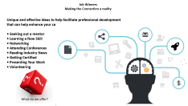
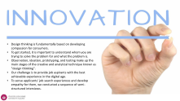


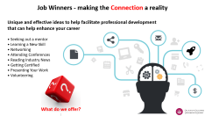
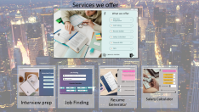
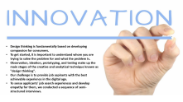

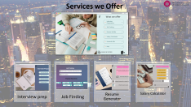


Slide 2

Design thinking is fundamentally based on developing compassion for consumers.
To get started, it is important to understand whom you are trying to solve the problem for and what the problem is.
Observation, ideation, prototyping, and testing make up the main stages of the creative and analytical technique known as "design thinking".
Our challenge is to provide job aspirants with the best achievable experience in the digital age.
To sense applicants' job search experiences and develop empathy for them, we conducted a sequence of semi-structured interviews.

Slide 3
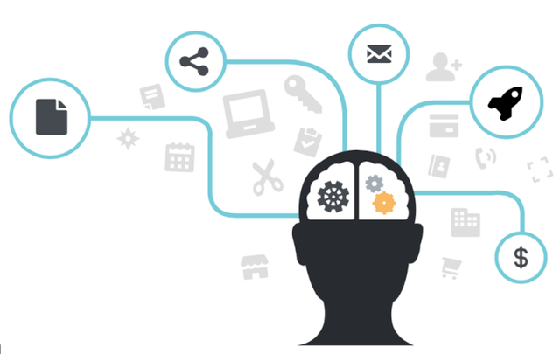

Job Winners - making the Connection a reality
Unique and effective ideas to help facilitate professional development
that can help enhance your career
• Seeking out a mentor • Learning a New Skill • Networking • Attending Conferences • Reading Industry News • Getting Certified • Presenting Your Work • Volunteering
What do we offer?

Slide 4

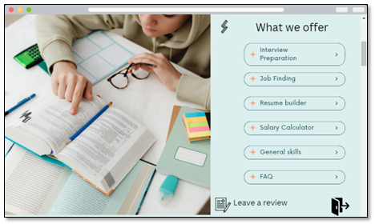
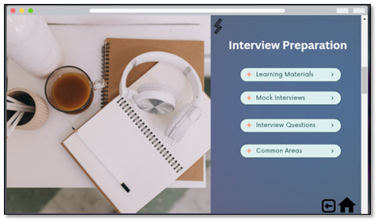
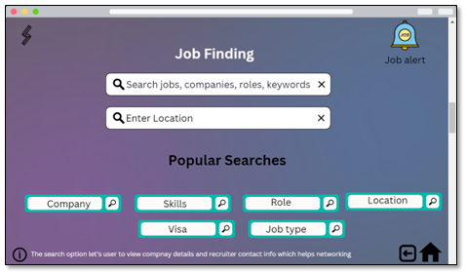
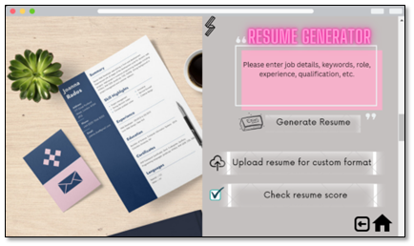
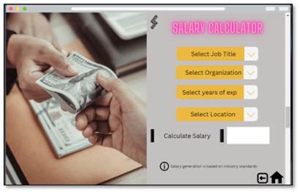
Services we Offer
Salary Calculator
Interview prep
Job Finding
Resume Generator

Slide 5

Conclusion
The Job Market is Competitive - How to Differentiate Yourself and Land Your Ideal Position.
Creating an irresistible Customer Value Proposition - Think outside the box.
The job market can be a difficult and complicated landscape to traverse.
Do your homework - research your potential employer to get an in-depth understanding of their organization.
Network - Leveraging your networking and engagement opportunities to get your foot in the door.
Showcase Your Value - You will be one step closer to landing your ideal position.
​
​
💭 Next Steps - Think about ​ Scope (implementations & deliverables)​ Budget (expenses & revenue)​ Sustainability (progress measures & life cycle)
Global (find opportunities worldwide)

Slide 6

any questions you may have ???

